Slide 1
Functions and Structured Programming

Slide 2
Function definition
Here is the formal presentation of the way we define functions. You have already done this a lot. The function main follows this format.
type function_name ( parameter_type_list)
{
declarations
statements
}
Here type is the type of data that will be used in the return statement. If none, then use the keyword void.
The parameter_type_list is just the list of identifiers the function will receive when it is called. They look like declarations but are separated by commas. They are often called formal parameters.
The part of the function preceeding the opening the brace is called the function header. The part between the braces is the function body.

Slide 3
Function prototype
The function prototype tells the compiler about a function you will be invoking in your program. You invoke the printf and scanf functions, their prototypes are in the stdio.h file that you include. Most times that you invoke a function written by someone else, you will include a header file they supply that contains the function prototype. This one says that the prn_message function takes no arguments (like the main functions we have written), because the parameter_type_list contains the keyword void. The function does not return a value, that is why unlike main, it has type void.
If the function takes a variable number of arguments, as scanf and printf do, the argument list will contain an ellipsis. (i.e. …). Here is printf’s prototype, don’t worry about the things you don’t understand, notice that after the first argument which is called __restrict__format, that an ellipsis occurs, this says more arguments may be supplied but are not required.
  extern int printf (__const char *__restrict __format, ...) __THROW;

Slide 4
Example: prn_message program
#include <stdio.h>
void prn_message(void); /* function prototype */
int main(void)
{
prn_message(); /* function invocation */
return 0;
}
void prn_message(void) /* function definition */
{
printf(“A message for you: “);
printf(“Have a nice day!\n”);
}

Slide 5
Dissection of prn_message
void prn_message(void); /* function prototype */
  The prn_message function takes no arguments (like the main functions we have written), because the parameter_type_list contains the keyword void. The function does not return a value, that is why unlike main, it has type void.
prn_message(); /* function invocation */
  This is how we would call this function. Notice how we did not supply any arguments, (the stuff in the parenthesis). This is consistent with the prototype which showed a void parameter_type_list. Also notice we did not assign the return value from the function, like we would with scanf. This is because, according to its prototype it doesn’t return a value.
The compiler will usually complain if your invocation doesn’t match the prototype.

Slide 6
Dissection of prn_message continued
void prn_message(void) /* function definition */
{
printf(“A message for you: “);
printf(“Have a nice day!\n”);
}
  The function definition is the “moving parts” of a function. So far you have always only written the function definition for the main function. However, you can have as many function definitions in a program as you would like. When the prn_message function is invoked control passes to the first statement in the function. When the closing brace is reached the control passes back to the function calling prn_message. In fact to the first statement after the call.
  In our example, this is the return statement in our main function. Notice, the oversight in the text, in their version of the program, the main function did not return a value, but it was defined as type int.

Slide 7
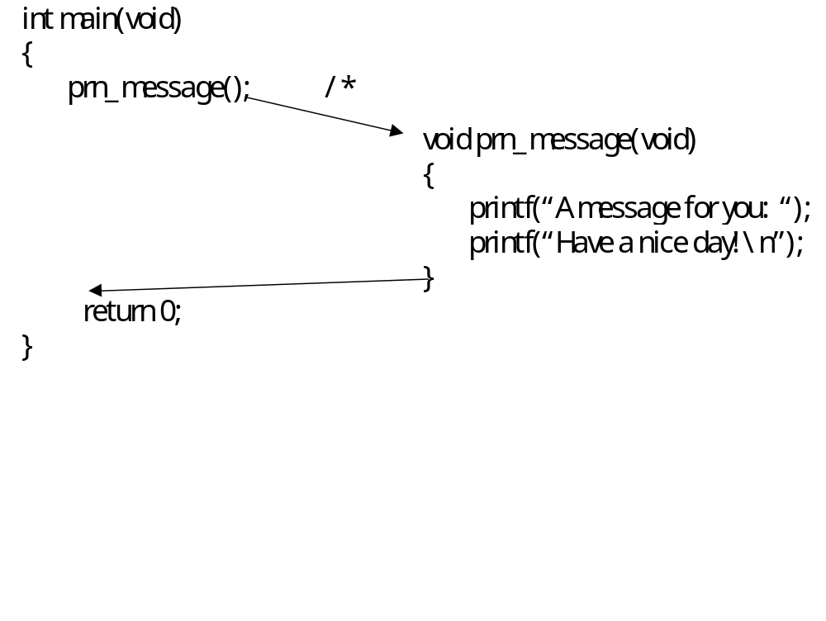
Control flow in prn_message program

Slide 8
Message Program
#include <stdio.h>
void prn_message(int k);
int main(void)
{
int how_many;
printf (“%s%s”, “There is a message for you.\n”,
“How many times do you want to see it\n? “);
scanf(“%d”, &how_many);
prn_message(how_many);
}
void prn_message(int no_of_messages)
{
int i;
printf(“Here is the message\n”);
for ( i = 0; i < no_of_messages; ++i )
printf(“ Have a nice day!\n”);
}

Slide 9
Message Program Discussion
void prn_message(int k);
  The prn_message function will be “passed” a single value. The value will be of type int. The name, k, given the parameter in the prototype is not important, in fact providing a name here is optional.
prn_message(how_many);
Notice that the type of how_many is int. When the main function invokes the prn_message function, the current value of how_many will be given as the first argument to prn_message. The prn_message function cannot “see” the how_many variable, because it is inside the braces. (Informally, think of being unable to “see” inside braces.
void prn_message(int no_of_messages)
Notice that there is no declaration for no_of_messages in the body of prn_messages. You don’t declare formal parameters. Before the body of the function executes, no_of_messages will be give the value passed to the function. In this case, it is as if we had seen an assignment to no_of_messages from how_many.
for ( i = 0; i < no_of_messages; ++i )
  This loop will be executed the number of times that no_of_messages contains. As it turns out, this will be exactly the value of how_many.

Slide 10
Return statements
return expression;
Here expression evaluates to a valid type of data in C, such as int, char, float, etc. The type of the expression must match the type of the function shown in the definition header, and also must match the type shown in the function prototype. If the function has type void, then expression will be empty. The value in expression is calculated when the return statement is encountered, this value is return to the calling function. A function need not have a return statement. In this case, it will return at the closing brace and no value will be returned. Of course, in this case, it should be defined as type void.

Slide 11
Return example
#include <stdio.h>
int called_function(void); /* prototype of called_function */
int main(void)
{
int returned_value;
returned_value = called_function();
printf(“The function called_function returned a %d.\n”,returned_value);
}
int called_function(void)
{
return 5;
}
This program will print the result:
The function called_function returned a 5.

Slide 12
The Minimum Program
#include <stdio.h>
int min( int a, int b );
int main(void){
int j, k, minimum;
printf(“Input two integers: “);
scanf ( “%d%d” , &j, &k );
minimum = min(j, k);
printf(“\nOf the two values %d and %d, “
“the minimum is %d. \n\n”, j, k, minimum);
return 0;
}
int min(int a, int b){
if ( a < b )
return a;
else
return b;
}

Slide 13
The Minimum Program discussion
minimum = min(j, k);
Here the function min is invoked. The first thing that happens is that in the min function the identifier a is given the current value of j, the identifier b is given the current value of k.
int min(int a, int b)
a and b have are assigned the values from the main function, they do not refer to the same location in memory. It doesn’t matter what the min function does, the values j and k in the main function are unchanged. We will see later, how to allow a called function to change a value in the calling function. (Hint, think about scanf…).
if ( a < b )
return a;
else
return b;
This if statement results in the return of a value of type int. As we have seen, this matches the type of min in its function definition.

Slide 14
Why write functions
Imagine that instead of simply invoking the printf function each time, you had to write the code that accomplished what this function does, your code would need to convert various data types to character strings and write it to a file named stdout. Whenever you want to invoke some code from multiple points in a program, or from multiple programs you should consider writing a function.
Even when code is only invoked from one place in a program, it can make a program much easier to read if a logically separable block of code is written as a function and simply invoked. (Even if min(a,b) is invoked only once, it is easier to see the invocation then the code.)

Slide 15
Top-Down Design of Running Sums
Problem:
  Read a file of integers, for each integer, print out the count, the sum of all integers read to this point ( subtotal), the smallest integer seen to this point and the maximum integer seen to this point. The page should start with a banner and all output should be aligned in columns under appropriate headings.
  Output example:
  *************************************************
  * RUNNING SUMS, MINIMUMS, AND MAXIMUMS *
  *************************************************
  Count Item Sum Minimum Maximum
  1 19 19 19 19
  2 23 42 19 23
We can use top-down design to break this into subproblems that together solve the original problem.

Slide 16
Subproblems in Running Sums
Subproblems
  Print a banner
  Print column heading.
  Read the data and print it neatly in columns.
A natural way to attack the problem is to implement the different subproblems as different functions. Then the controlling function, which is main() in this case, would simply invoke these functions at the right time.

Slide 17
Running Sums: main function
#include <stdio.h>
void prn_banner(void);
void prn_headings(void);
void read_and_prn_data(void);
int min( int a, int b);
int max( int a, int b);
int main(void){
prn_banner();
prn_headings();
read_and_prn_data();
return 0;
}

Slide 18
Running Sums: Easy functions
void prn_banner(void){
printf(“\n%s%s%s\n”,
“*************************************************\n”,
“* RUNNING SUMS, MINIMUMS, AND MAXIMUMS *\n,
“*************************************************\n”);
void prn_headings(void){
printf(“%5s%12s%12s%12s%12s%12s\n\n”,
“Count”, “Item”, “Sum”, “Minimum”, “Maximum”);
}

Slide 19
Running Sums: read_and_prn_data
void read_and_prn_data(void){
int count = 0 , item, sum, smallest, biggest;
if (scanf(“%d”, &item) == 1) {
++count;
sum = smallest = biggest = item;
printf(“%5d%12d%12d%12d%12d\n”,
count, item, sum, smallest, biggest);
while (scanf(“%d”, &item) == 1) {
++count;
sum += item;
smallest = min ( item, smallest );
biggest = max ( item, biggest );
printf(“%5d%12d%12d%12d%12d\n”,
count, item, sum, smallest, biggest);
}
}
else
printf(“No data was input - bye! \n\n”);
}

Slide 20
The assert() macro
During development you may want to have the compiler insert code to ensure conditions are satisfied in your program. The assert() macro can be used for this purpose.
Usually, this is written as
  assert (expression)
  The compiler will insert code into your program which will evaluate expression, if it is true, processing continues with the next statement, otherwise an error message is printed and the program stops.
  Define the macro, NDEBUG in your program, and assert statements are ignored. Thus, they can be left in when development is over.
  #define NDEBUG
  is one way you could define NDEBUG in your program. Alternatively, you could ask most compiler to define it as follows:
  gcc read_and_prn_data.c -D NDEBUG
  The compiler compiles the read_and_prn_data.c file as if it contained
  #define NDEBUG

Slide 21
assert() example
#include <assert.h>
double f(int a, int b)
{
double x;
assert(a > 0); /* precondition */
assert(b >= 7 && b <= 11); /* not 7 <= b <= 11 */
…
assert(x >= 3.0); /* postcondition */
return x;
}

Slide 22
Function Declarations: Declared as first seen
Suppose the first line in your file referring to function f() is an invocation, like:
  f(x)
  The compiler will treat as if its has seen the prototype:
  int f();
  In other words, it is assumed to return type integer, no type checking is done with its formal parameters.
  You get the same effect if you used the function prototype
  int f(x) /* traditional (non-ANSI) C */
  double x; /* No checking that double is passed */
  {
  ……….
  Best choice is full prototype:
  int f(double x) /* ANSI C style */
  Now the compiler can help you be ensuring you always pass a double to f.

Slide 23
Random Numbers
Random numbers are sometimes used in generating test data for programs. Monte Carlo simulations are programs that use random number functions to generate probabilities.
In C, you can obtain apparently random numbers by invoking the function rand(). This function returns pseudo-random numbers in the system dependent interval 0 ,…, n.

Slide 24
Random Number Example:
#include <stdio.h>
#include <stdlib.h>
int max(int a, int b);
int min(int a, int b);
void prn_random_number( int k);
int main(void){
int n;
printf(“Some random numbers will be printed.\n”);
printf(“How many would you like to see? “);
scanf(“%d”, &n);
prn_random_numbers(n);
return 0;
}

Slide 25
prn_random_numbers
void prn_random_numbers( int k){
int i, r, biggest, smallest;
r = biggest = smallest = rand ();
printf( “\n%7d”, r);
for ( i = 1; i < k; ++i ) {
if (I % 7 == 0)
printf(“\n”);
r = rand();
biggest = max( r, biggest );
smallest = min (r, smallest );
printf(“%7d”, r);
}
printf(“\n\n%s%5d\n%s%5d\n%s%5d\n\n”,
“ Count: “, k,
“Maximum: “, biggest,
“Minimum: “, smallest);
}

Slide 26
Alternate Style for Function Definition
#include <stdio.h>
#include <stdlib.h>
int max(int a, int b){
…
}
int min(int a, int b){
…
}
void prn_random_numbers(int k){
…
}
int main(void){
…
}

Slide 27
Programs from multiple source files
If your project had a large number of functions it is dramatically faster to only recompile those that have changed.
A large program can be built by combining multiple source files. For example, suppose file1.c file2.c and file3.c are files containing the functions of a large program.
    You could compile them all and create your program as follows:
      gcc file1.c file2.c file3.c -o myprogram
      This creates the file myprogram from the three source files.
      Each program is recompiled each time.
    Alternatively you can create three object files
      gcc -c file1.c
      gcc -c file2.c
      gcc -c file3.c
      - You then invoke the linkage editor to combine the object files into the program. Here is how it looks in UNIX.
      gcc -o file1.o file2.o file3.o
    In UNIX, object files usually have .o as their suffix in Windows it is .obj

Slide 28
Prn_random_numbers in three files
Common practice to place all #defines and function prototypes in header file for a programming project. Sometimes in large projects there are multiple header files.
To see an example, we will break prn_random_numbers into two source files and one header file.
  Header file will be prn_random.h and contains function prototypes. It will be included in the source files.
  Source file prn_random_main.c will have the functions main and prn_random.
  Source file min_and_max.c will have the source for the max and min functions.
File prn_random.h
  /* This header file contains the function prototypes for the prn_random project. */
  int min(int a, int b);
  int max(int a, int b);
  void prn_random_numbers( int k);

Slide 29
Prn_random_numbers in three files: Source files
File prn_random_main.c
  #include <prn_random.h>
  int main(void){ /* Definition of main */
  …
  }
  void prn_random_numbers( int k ){ /* Definition of prn_random_numbers */
  …
  }
File min_and_max.c
  #include <prn_random.h>
  int min(int a, int b) ){ /* Definition of min */
  …
  }
  int max(int a, int b) ){ /* Definition of max */
  …
  }

Slide 30
Example: Game of Heads or Tails
Simulate child’s game of calling heads or tails:
  first child tosses coin, second child wins by guessing heads or tails.
  Simulate coin toss by using rand(). Even number is heads.
    Use of rand() function is example of Monte Carlo simulation.
    Program prints results after each coin toss and a final report.
Good practice to have a directory containing all the files for this project and no other files.
  UNIX command to create directory heads_or_tails is:
    mkdir heads_or_tails
  UNIX command to enter directory heads_or_tails is:
    cd heads_or_tails
  UNIX command to return to home directory is:
    cd
This project uses files: heads_or_tails.h, main.c, get.c, play.c, and prn.c

Slide 31
Heads_or_Tails: heads_or_tails.h
#include <stdio.h>
#include <stdlib.h>
#define MAXWORD 100
int get_call_from_user( void);
void play( int how_many);
void prn_final_report( int win, int lose, int how_many );
void prn_instructions(void);
void report_a_win( int coin );
void report_a_loss ( int coin );
int toss ( void);

Slide 32
Head_or_tails: main.c
#include <heads_or_tails.h>
int main( void ){
char ans;
int no_of_plays;
printf(“ \n”
“THE GAME OF HEADS OR TAILS\n”
“\n”
“Do you want instructions? “);
scanf( “ %c”, &ans);
putchar(‘\n’);
if (ans == ‘y’ || ans == ‘Y’ )
prn_instructions();
printf(“How many times do you want to play? “);
scanf(“%d”, & no_of_plays);
putchar(‘\n’);
play ( no_of_plays);
return 0;
}
Notes:
Note:
putchar puts a single character to the terminal. Note the use of single quotes to denote a single character.
Note the if statement. Notice how the char data type is compared with constants denoted with single quotes. Common mistake is to write:
if (ans == “y” || ans == “Y”)
Note the first printf, multiple strings are shown on different lines. These are treated as if they were a single string formed by concatenating the four strings. The difference from being arguments to printf is the lack of the comma separating the strings.

Slide 33
Head_or_tails: get.c
#include <heads_or_tails.h>
int get_call_from_user(void){
int guess; /* 0 = heads, 1 = tails */
do {
printf( “Cal it: “);
if (scanf( “%d”, &guess ) != 1) {
printf(“\nSORRY: Severe input error -bye!\n\n”);
exit (1); /* ends program execution as if main had returned value 1*/
}
if (guess != 0 && guess != 1) {
printf(“\n%s\n\n”,
“ERROR: Type 0 for heads, 1 for tails.”);
}
} while ( guess != 0 && guess != 1);
return guess;
}
Notes:
Note:
putchar puts a single character to the terminal. Note the use of single quotes to denote a single character.
Note the if statement. Notice how the char data type is compared with constants denoted with single quotes. Common mistake is to write:
if (ans == “y” || ans == “Y”)
Note the first printf, multiple strings are shown on different lines. These are treated as if they were a single string formed by concatenating the four strings. The difference from being arguments to printf is the lack of the comma separating the strings.

Slide 34
Head_or_tails: play.c
#include <heads_or_tails.h>
void play( int how_many ){
int coin, i, lose = 0, win = 0;
for ( i = 0; i < how_many; i++ ) {
coin = toss():
if (get_call_from_user() == coin ) {
++win;
report_a_win(coin);
}
else {
++loss;
report_a_loss(coin);
}
}
prn_final_report( win, lose, how_many);
}
int toss(void){
return (rand() % 2); /* 0 = heads, 1 = tails */
}
Notes:
Note:
putchar puts a single character to the terminal. Note the use of single quotes to denote a single character.
Note the if statement. Notice how the char data type is compared with constants denoted with single quotes. Common mistake is to write:
if (ans == “y” || ans == “Y”)
Note the first printf, multiple strings are shown on different lines. These are treated as if they were a single string formed by concatenating the four strings. The difference from being arguments to printf is the lack of the comma separating the strings.

Slide 35
Head_or_tails: prn.c
#include <heads_or_tails.h>
void prn_instructions ( void ) {
printf(“%s\n”,
“This is the game of calling heads or tails. \n”
“I will flip a coin; you call it. If you\n”
“call it correctly, you win; otherwise, \n”
“I win. \n”
“\n”
“As I toss the (simulated) coin, I will\n”
“tell you to \”call it. \” To call heads, \n”
“type 0; to call tails, type 1.\n”);
}
void prn_final_report( int win, int lose, int how_many ) {
printf(“\n%s\n%s%3d\n%s3d\n%s%3d\n\n”,
“FINAL REPORT:”,
“ Number of games that you won: “, win,
“ Number of games that you lost: “, lose,
“ Total number of games: “, how_many);
}
Notes:
Note:
putchar puts a single character to the terminal. Note the use of single quotes to denote a single character.
Note the if statement. Notice how the char data type is compared with constants denoted with single quotes. Common mistake is to write:
if (ans == “y” || ans == “Y”)
Note the first printf, multiple strings are shown on different lines. These are treated as if they were a single string formed by concatenating the four strings. The difference from being arguments to printf is the lack of the comma separating the strings.

Slide 36
Function Invocation: Call by value
In C functions are always passed call-by-value.
  Some languages use a call-by-reference which allows the called function to modify the value of an argument, others can use either.
    C can also give the effect of call-by-reference, we will see how later. (scanf() )
  Call by value means the arguments are evaluated when the function is invoked. A COPY of the value of the evaluated argument is actually given to the function as the initial value of its formal parameters.

Slide 37
Example of Call by Value
#include <stdio.h>
int main(void) {
int n = 3, sum;
printf(“%d\n”, n); /* 3 is printed */
sum = compute_sum(n);
printf(“%d\n”, n); /* 3 is printed */
printf(“%d\n”, sum); /* 6 is printed */
return 0;
}
int compute_sum( int n){ /* sum ints from 1 to n */
int sum = 0;
for ( ; n > 0; --n ) /* In main(), n is unchanged */
sum += n;
printf(“%d\n”, n); /* 0 is printed */
return sum;
}

Slide 38
Recursion
A function can invoke itself :
  Suppose we wanted to print out a requested power of two.
    If 5 is requested, 32 is printed.
When a function is called recursively, it does not see the values of its previous calls!!
Pseudocode using recursion
  initialize: count = 0
  process:
    prompt user for power
    get power from user
    print_power( count, power, 1)
  print_power (count, power, result) pseudocode
  initialize:
  process:
    if count < power
    print_power( count + 1, power, result * 2)
    else
    output result

Slide 39
Example: Print Power of two
#include <stdio.h>
void print_power(int count, int power, int result);
int main(void){
int count = 0, power, result = 1; /* 2 to the 0 power is 1 */
printf( “Which power of two would you like to see? “);
scanf(“%d”, &power);
print_power(count, power, result);
}
void print_power(int count, int power, int result){
if (count < power)
print_power( ++count, power, 2 * result);
else
printf(“ two to the %dth power is %d\n”, power, result);
}

Slide 40
Recursion vs Iteration
Most recursive functions can be rewritten as iterative functions. Usually this will be much more efficient in memory usage and processor cycles.
Pseudocode using iteration for power of two program
  initialize: count = 0
  process:
    prompt user for power
    get power from user
    print_power( count, power, 1)
  print_power (power) pseudocode
  initialize:
    count = 0
    result = 1
  process:
    while count < power
    result = result * 2
    count = count + 1
    endwhile
    output result

Slide 41
Common Programming Errors with Functions
Reliance on automatic variables retaining their value between calls to a function.
Failure to initialize variables within functions
Passing parameters in wrong order.
Incorrect terminating conditions on recursive function calls.

